Slide 1
“ShopmE” ECOMMERCE website
Presented By :
Momin Minhaj.(223116)
Syeda Saman Fatima(223212)

Slide 2
>Points to be discussed
introduction
objective
Screenshots specification
s/w and H/W Requirement Advantages
Future Enhancement References.

Slide 3
Introduction
“ShopMe”is an Ecommerce website where the Admin can Add, Update and Delete products. The Products are divided into various categories like Books, Mobiles etc. A user can select a particular item to view the details, choose the number of items and fill in details like Name, Address, etc. to buy a product the project objective is to deliver the online shopping application into web platform. Online shopping is the process whereby consumers directly buy goods or services from a seller in real- time, without an intermediary service, over the Internet.
It is a form of electronic commerce. This project is attempts provide the advantages of online shopping to customers of a real shop. Thus, the customer will get the service of online shopping and home delivery from his favorite shop.

Slide 4
objective
"ShopMe" is a Business to Consumer online E-commerce application designed to create a smart online shopping opportunity for consumers. This shopping platform has a lot of features for consumers.It helps Customers who want to buy their necessary products in a user-friendly manner. The customers can simply visit the system, choose products from any category, register for an order, log into their accounts, and finally customers can edit their order list before order confirmation. It provides 24x7 support. Customers can make inquiries about any products or services and place orders anytime, anywhere from any location. The shopping website includes a range of electronic items, books, and other necessary products that consumers require daily. This online E-commerce system may be a complete solution for a customer which provides a flexible, safe, and user-friendly environment. A complete and efficient website which can provide the online shopping experience is the basic objective of the project.

Slide 5
goals
User, visitor would be easily visit site without login, also search products.
Registered user would be able to change his/her personal infomration whenever required
Manage the information of Members .
For each user ShopMe will maintain Shopping Cart. User will be able add product item with expected quatity
User can update or remove product items from Shopping Cart
After successful payment, Shopping Cart itmes would be converted into order and recipt generated.
Vendor would be able to add, remove, update product and can also edit product
informations.

Slide 6
purpose
The “Ecommerce” is developed according the current need in different Fields. “ShopMe” is Ecommerce Website which provides facility for purchasing Mobiles, Laptops, tabs and many more items. So by using this system users which want to purchase some products will first Register an account on this portal then Login through their Username and Password, and then Select items which they want to purchase and add them to cart and finally checkout. So by using this portal users can easily purchase products from their home.

Slide 7
Project scope
This system can be implemented to any shop in the locality or to multinational branded shops having retail outlet chains. The system recommends a facility to accept the orders 24X7 and a home delivery system which can make customers happy. If shops are providing an online portal where their customers can enjoy easy shopping from anywhere, the shops won’t be losing any more customers to the trending online shops such as FlipKart or eBay. Since the application is available and always available.

Slide 8
Front end backend language used
React js
Bootstrap
Html , css
Spring boot
Mysql

Slide 9
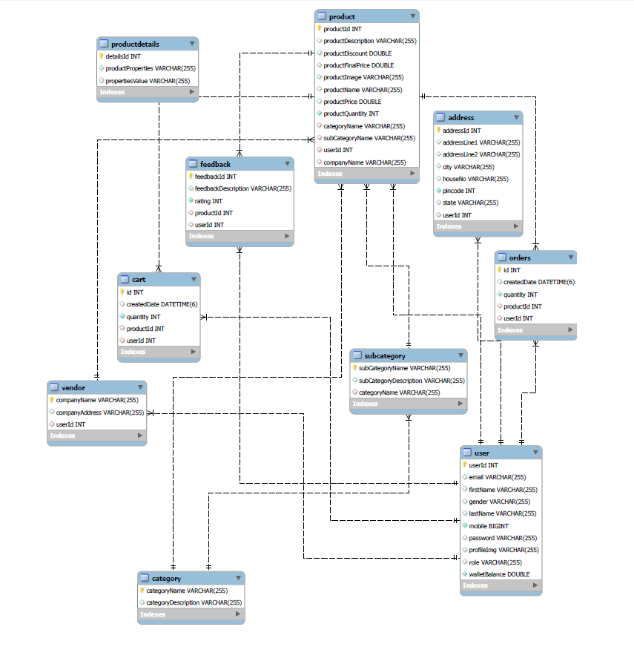
ER-Diagram

Slide 10
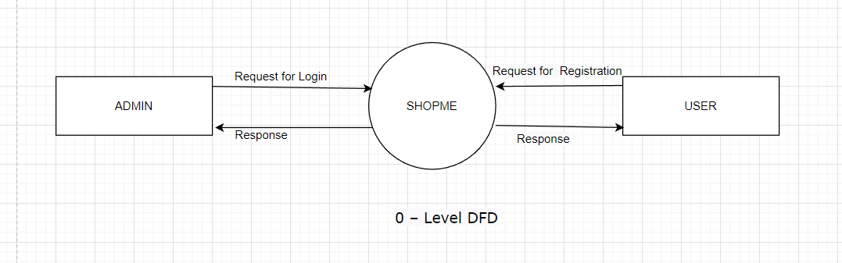
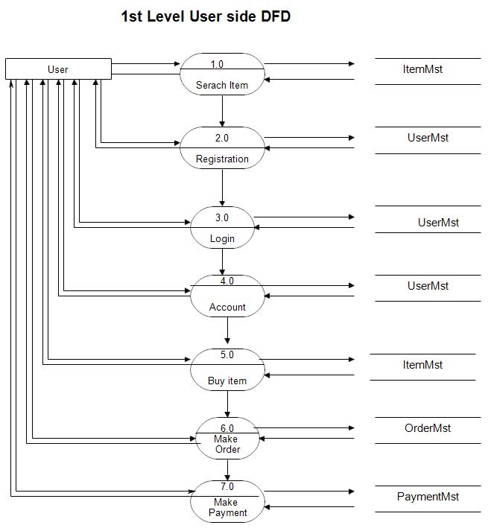
Data Flow diagram

Slide 11
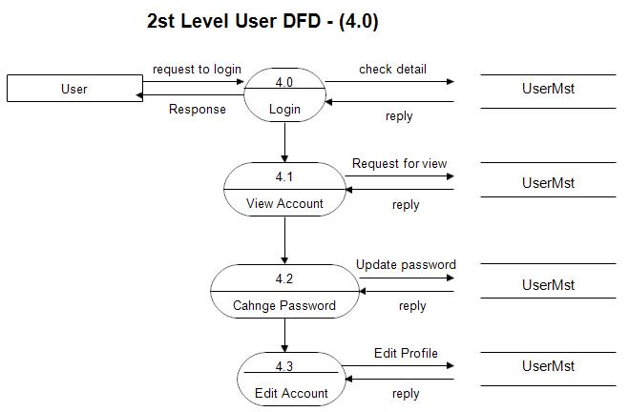

Slide 12
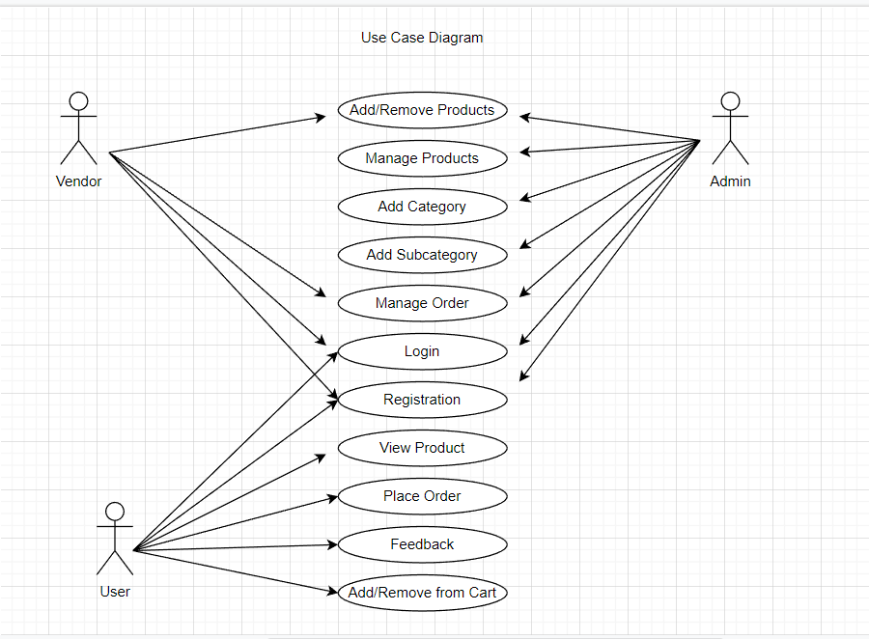
Use case Diagram

Slide 13
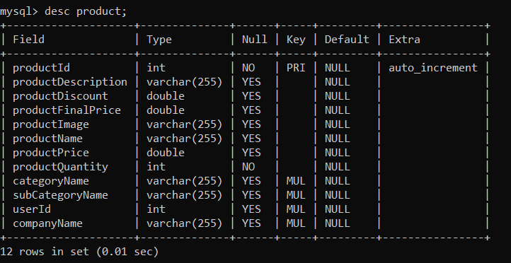
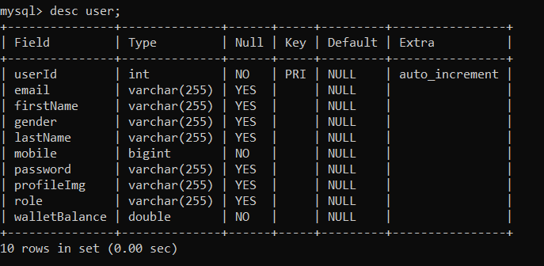
Data base Tables

Slide 14
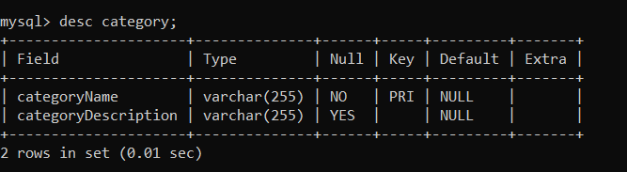
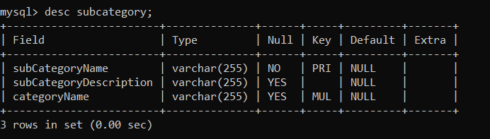
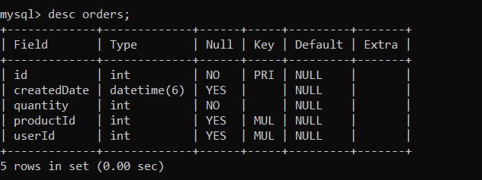
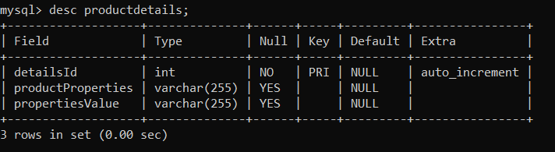
Data base tables

Slide 15
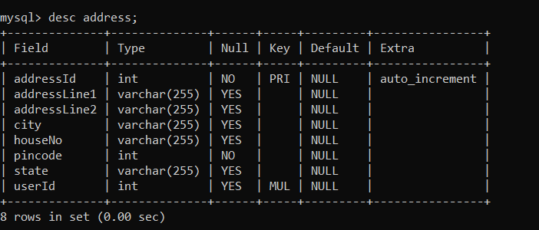
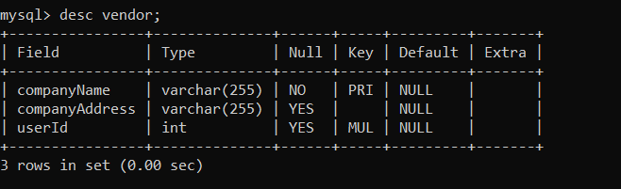
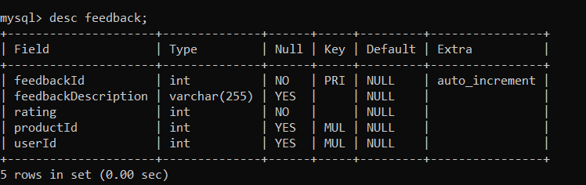
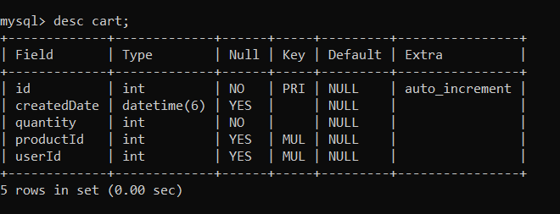
Data base tables

Slide 16
Conclusion
CONCLUSION:
“ShopMe” puts forth the actual working of a ECommerce. By providing functions like add products, buy products, view products etc. Online system makes easy communication between user and the system and makes flow easy and user-friendly.

Slide 17
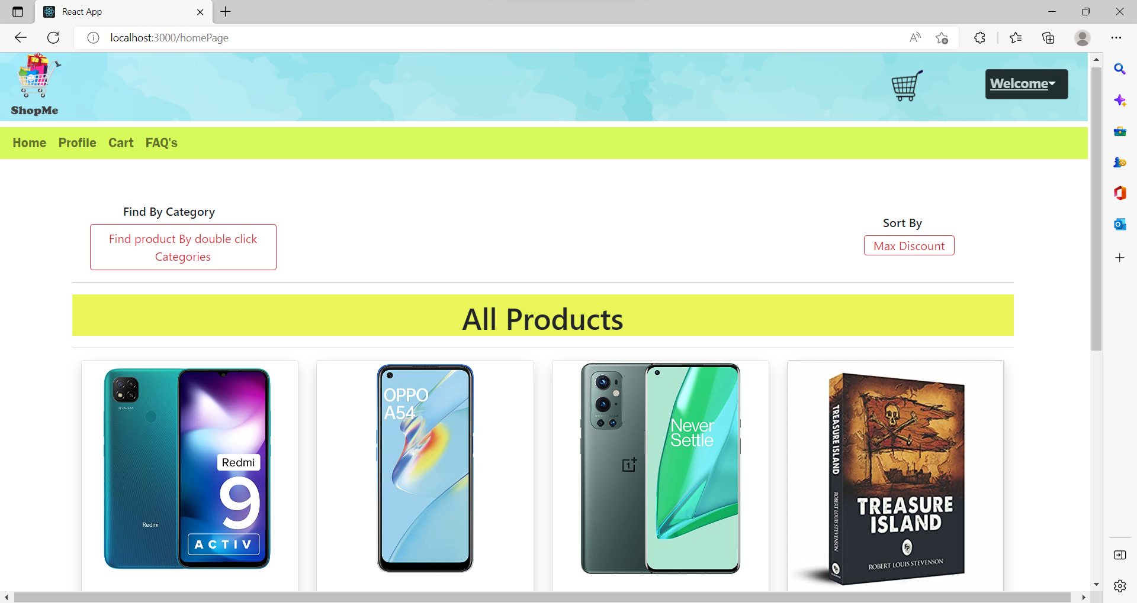
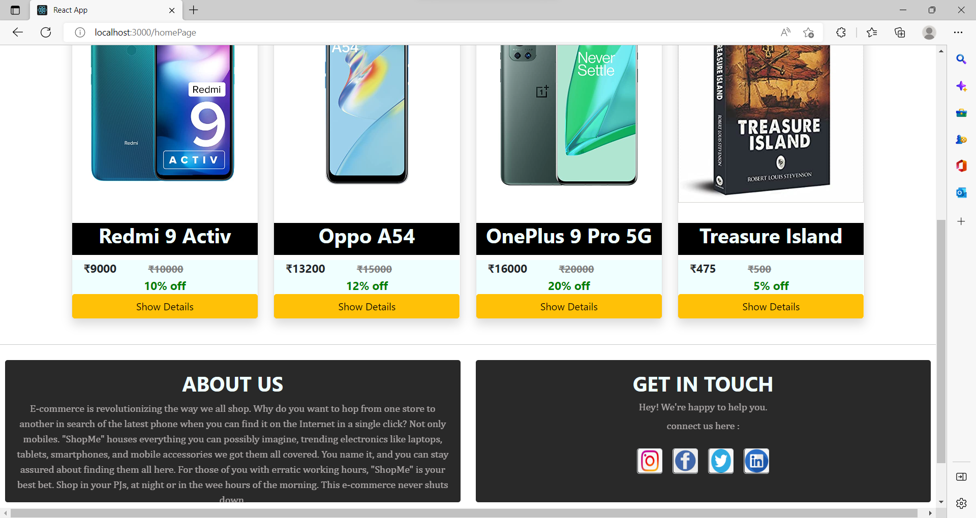
Prpject screen shots

Slide 18
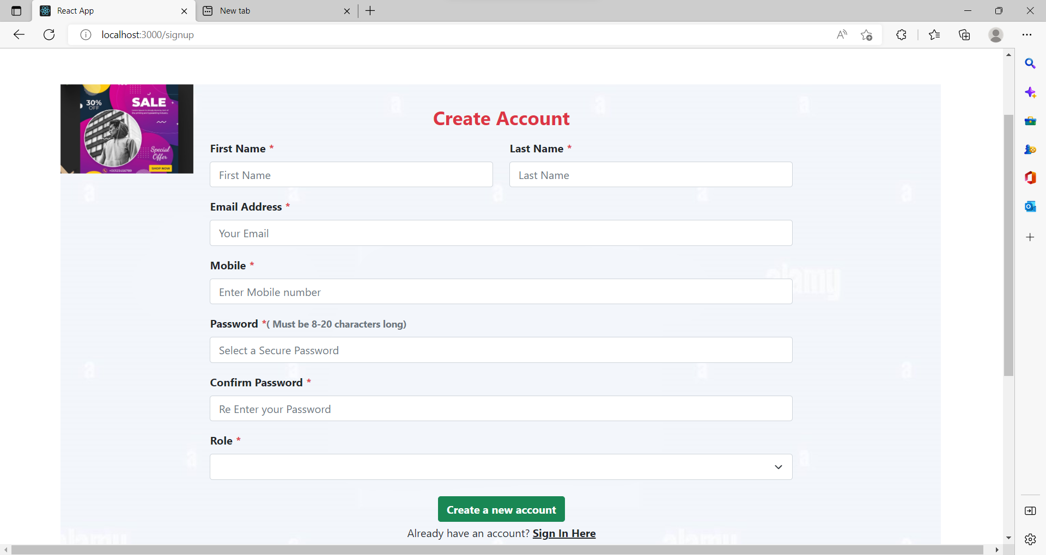
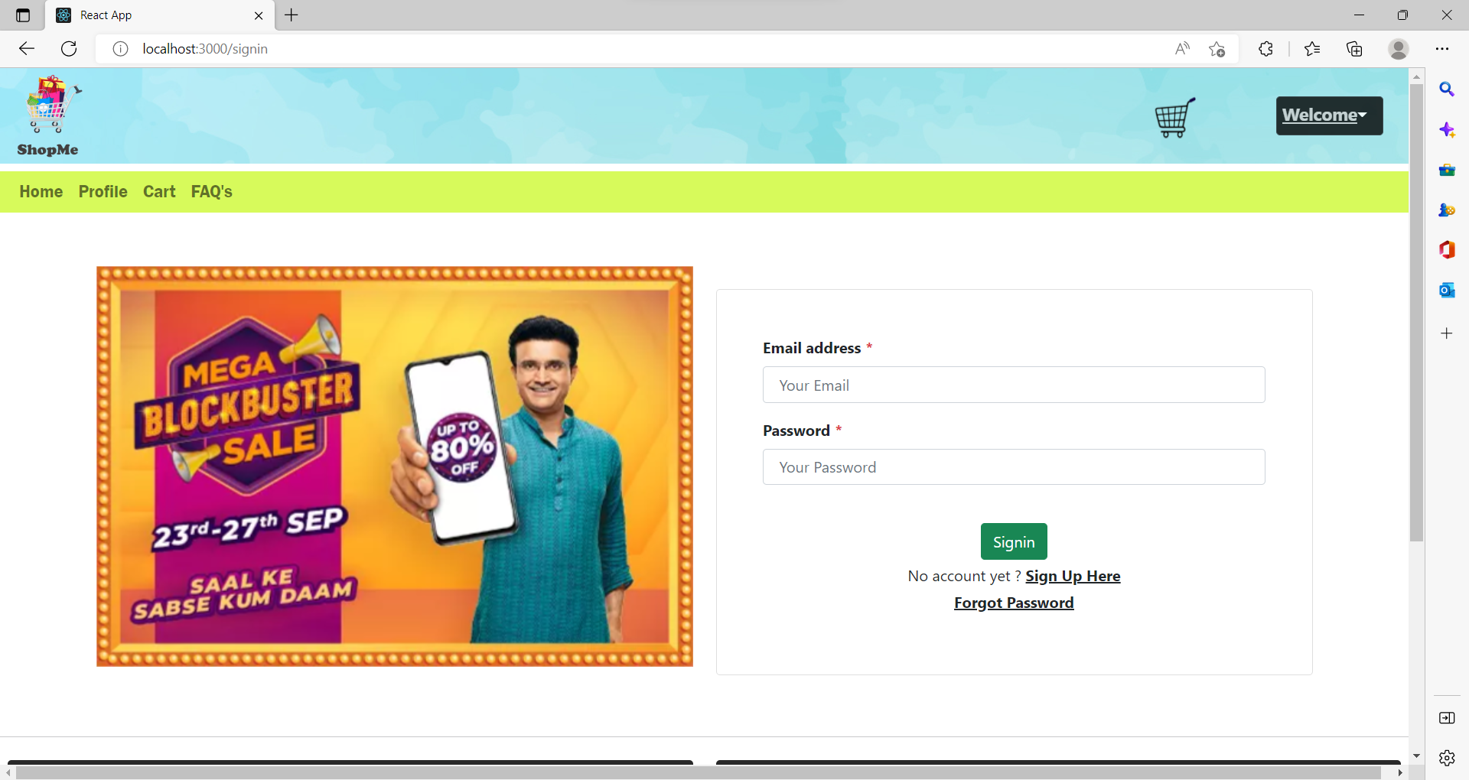

Slide 19
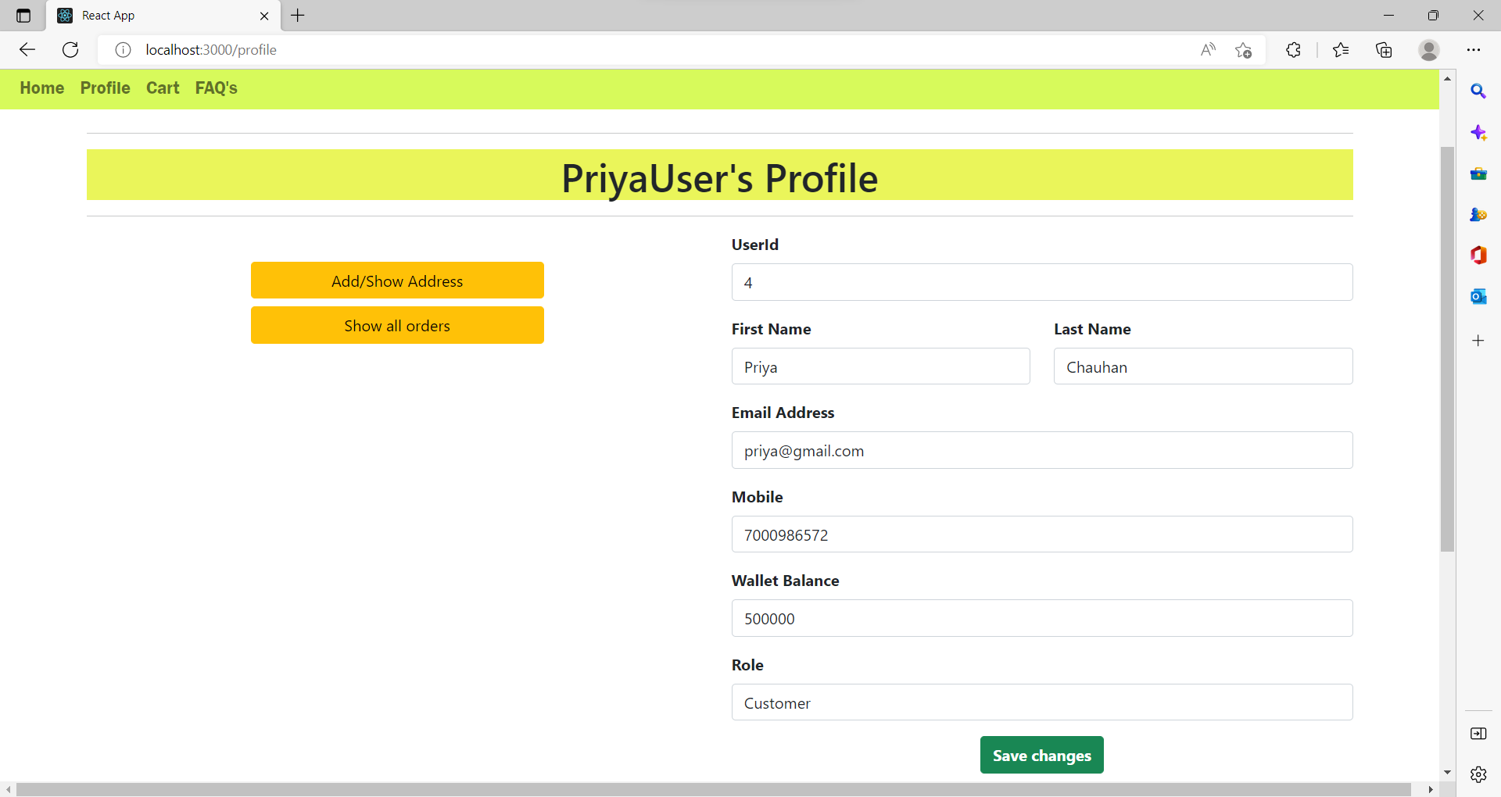
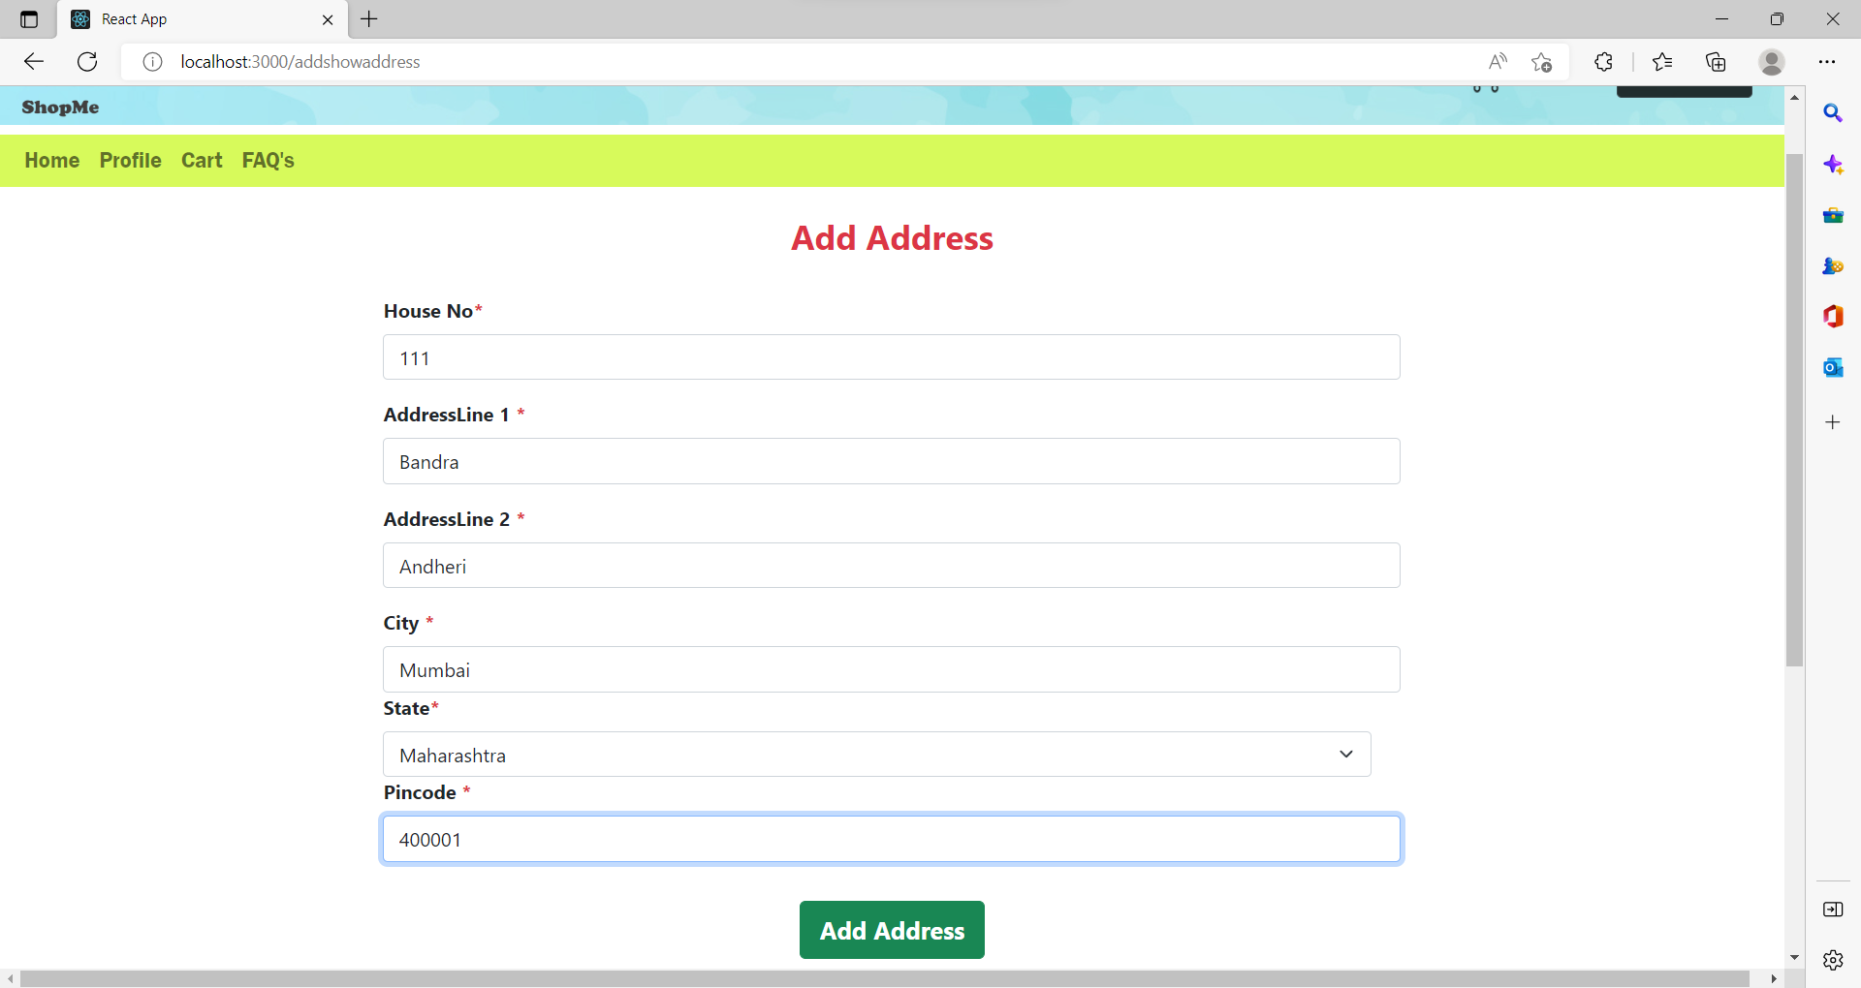

Slide 20
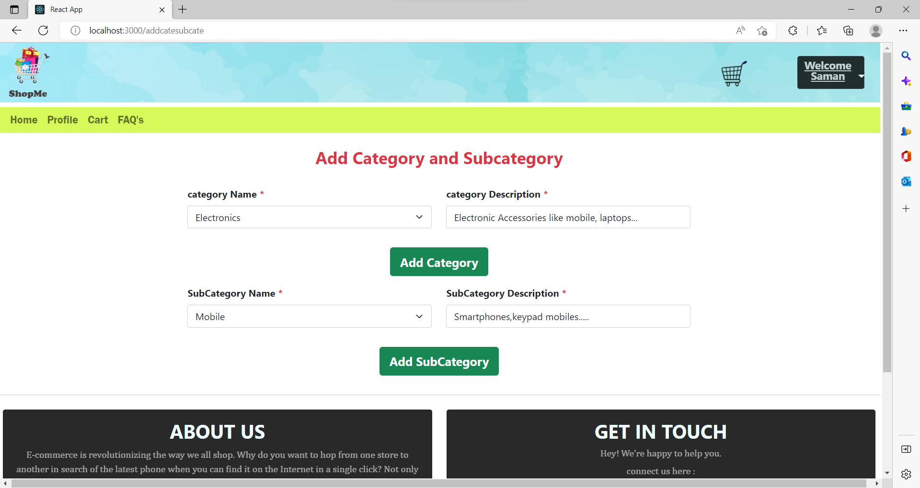
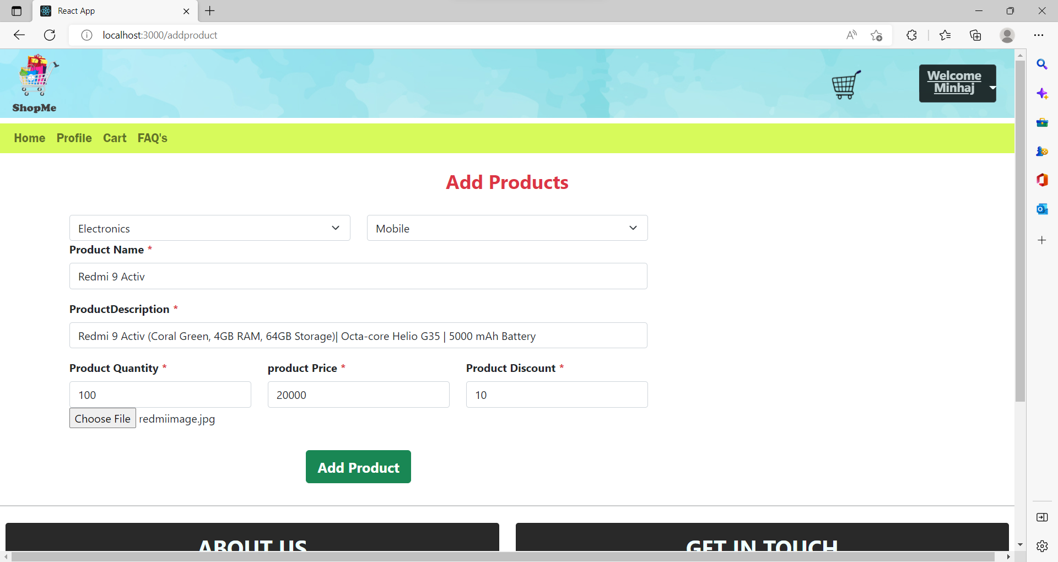

Slide 21
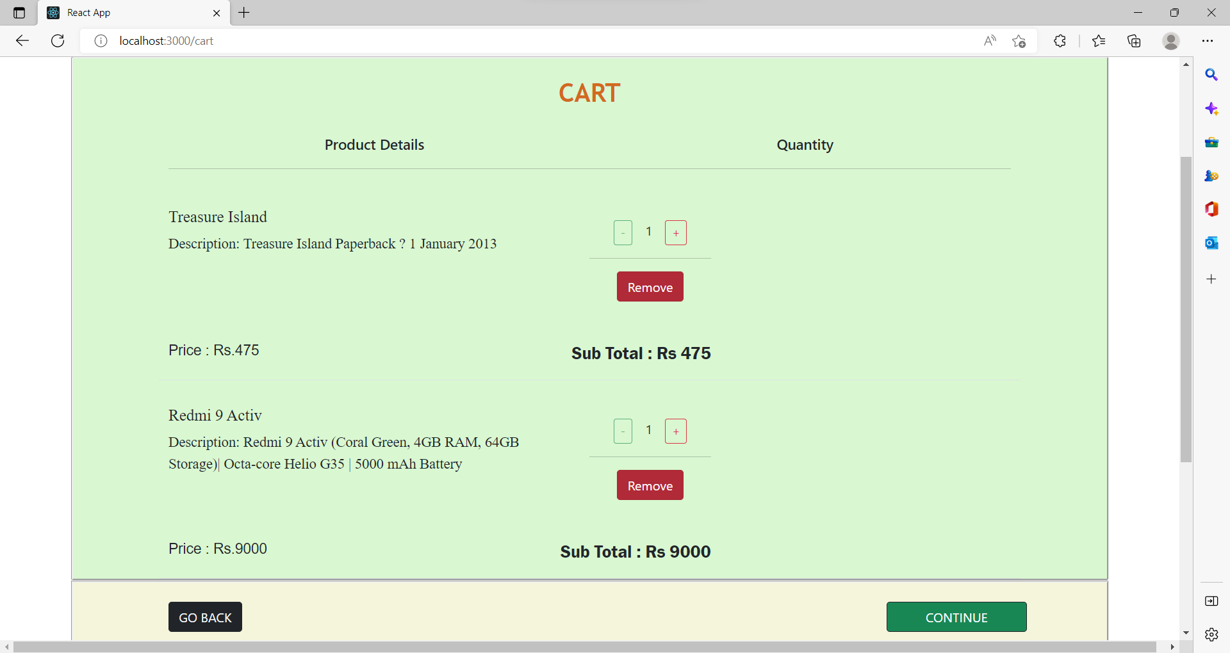
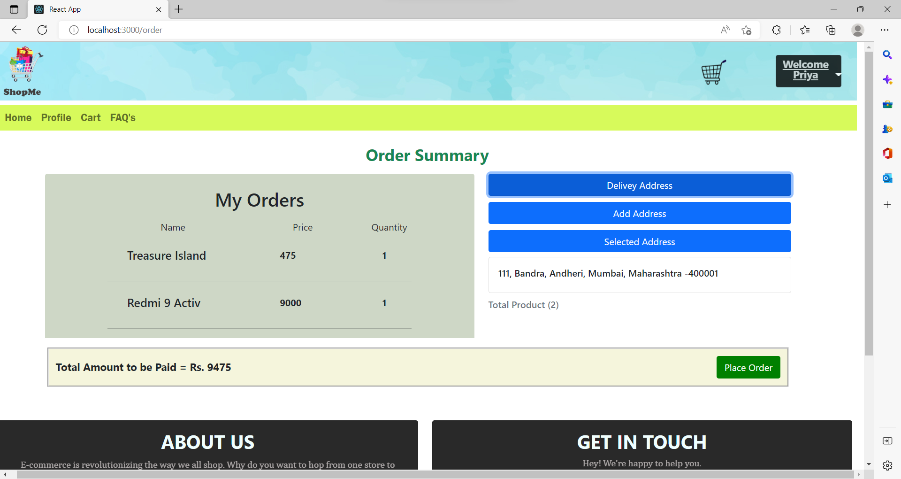

Slide 22
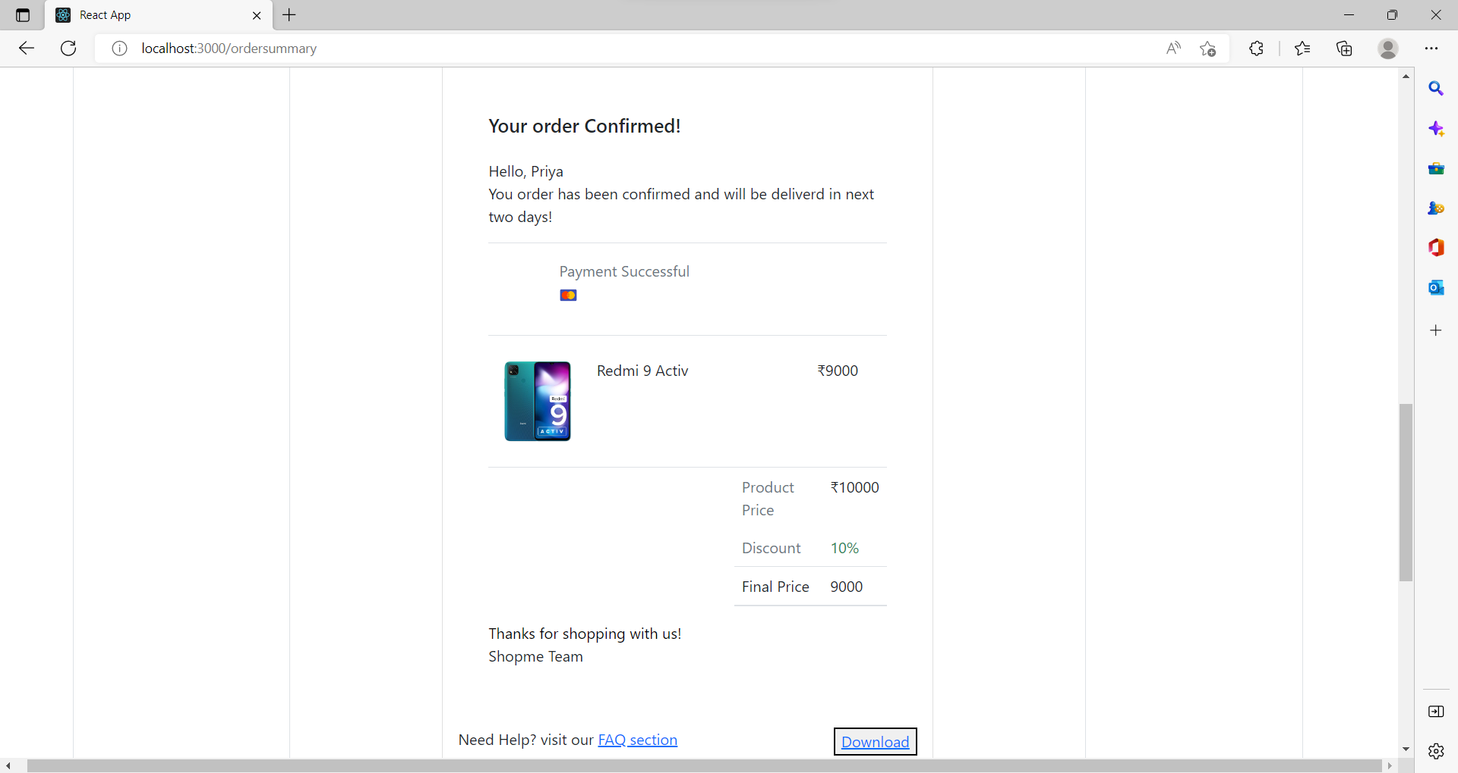
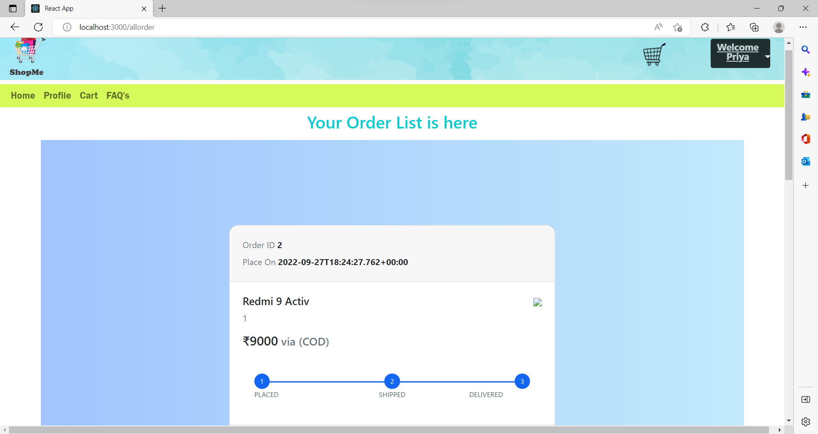

Slide 23
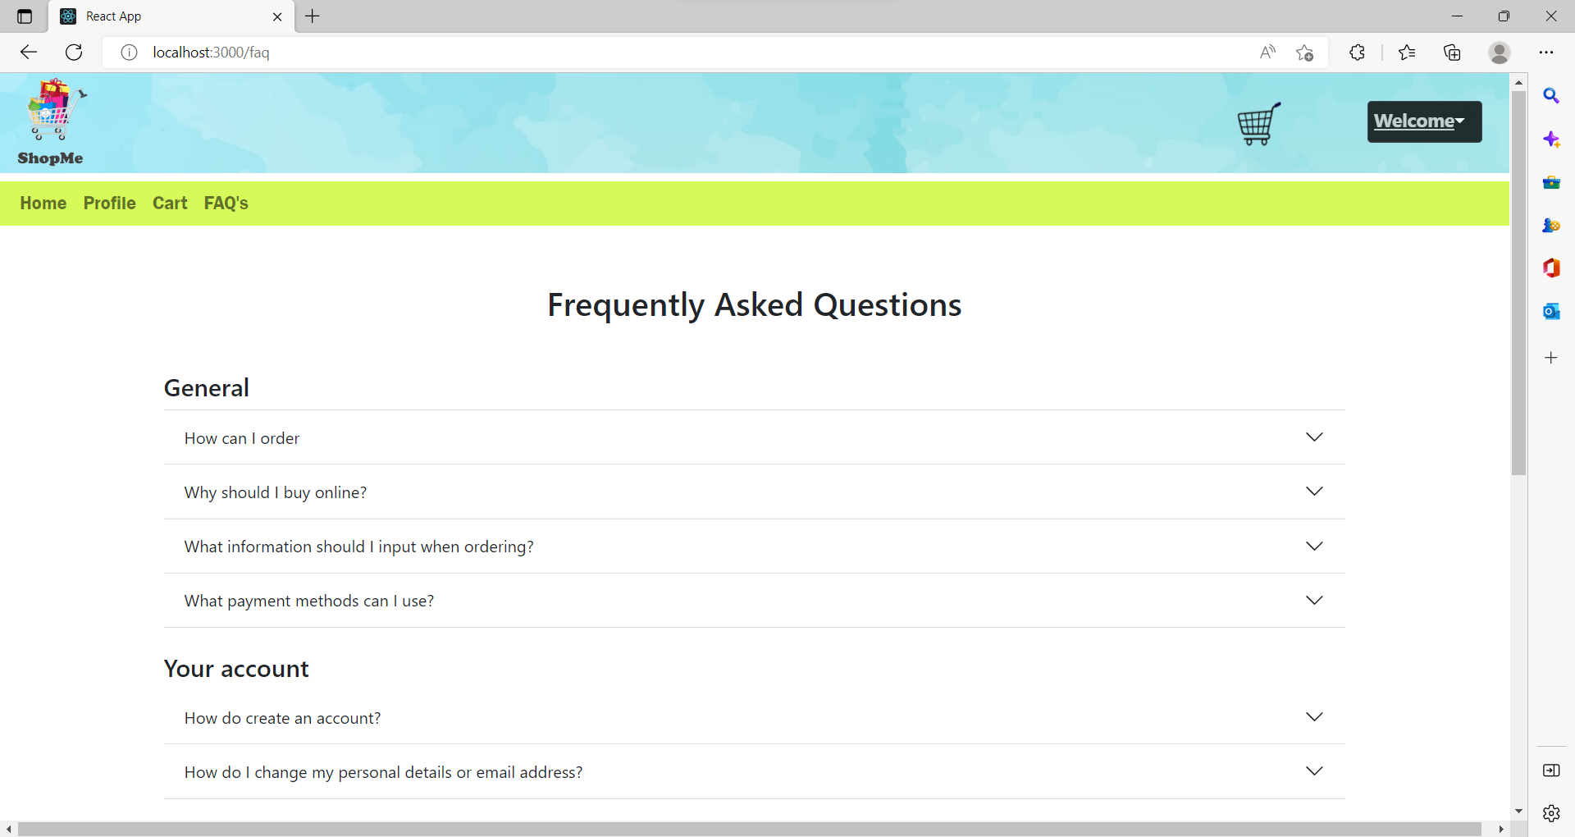

Slide 24
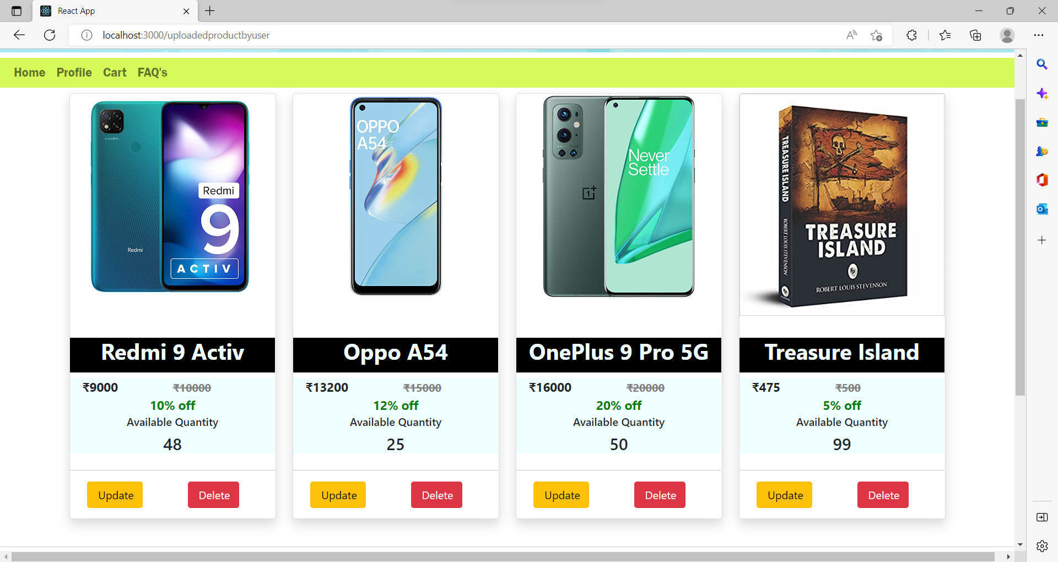
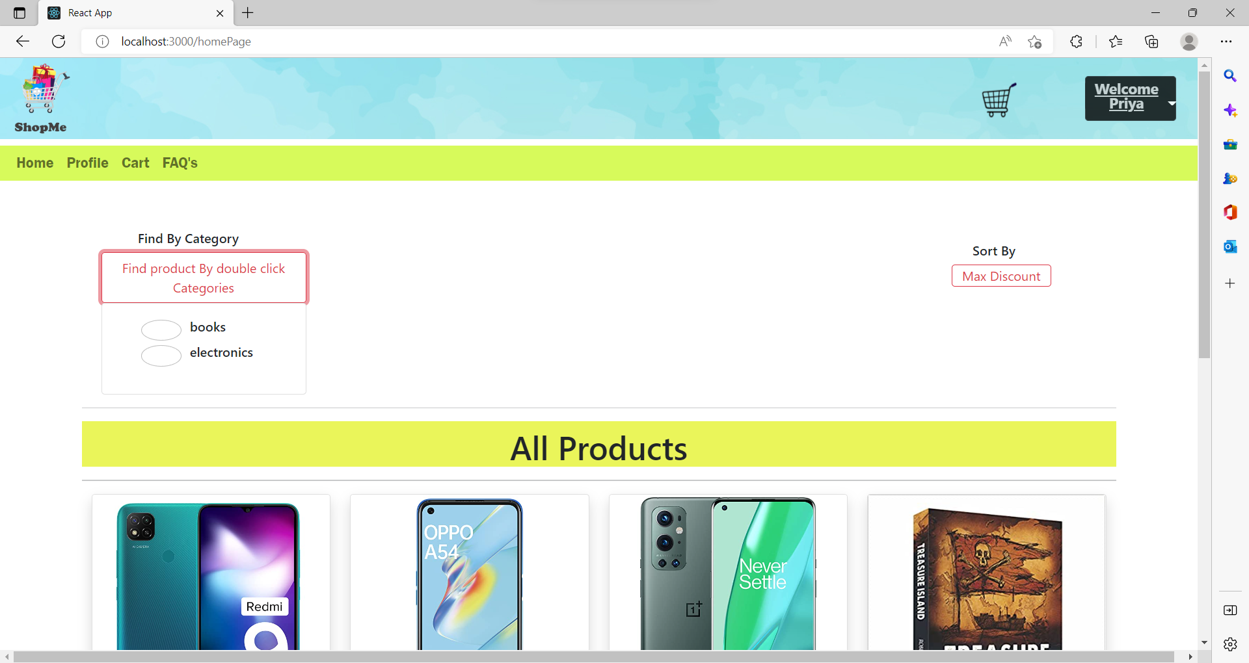

Slide 25
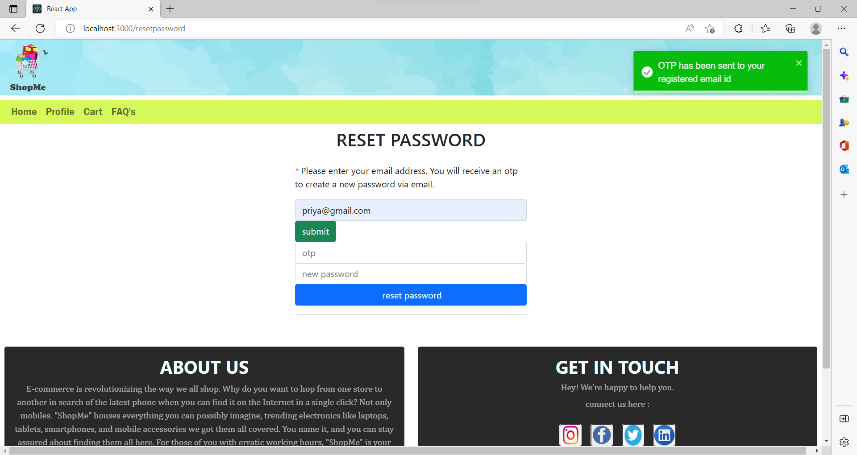

Slide 26
.Thank you .

